Slide 1
TS1 Components Testing
Library development in Visual Components
25.10.24

Slide 2
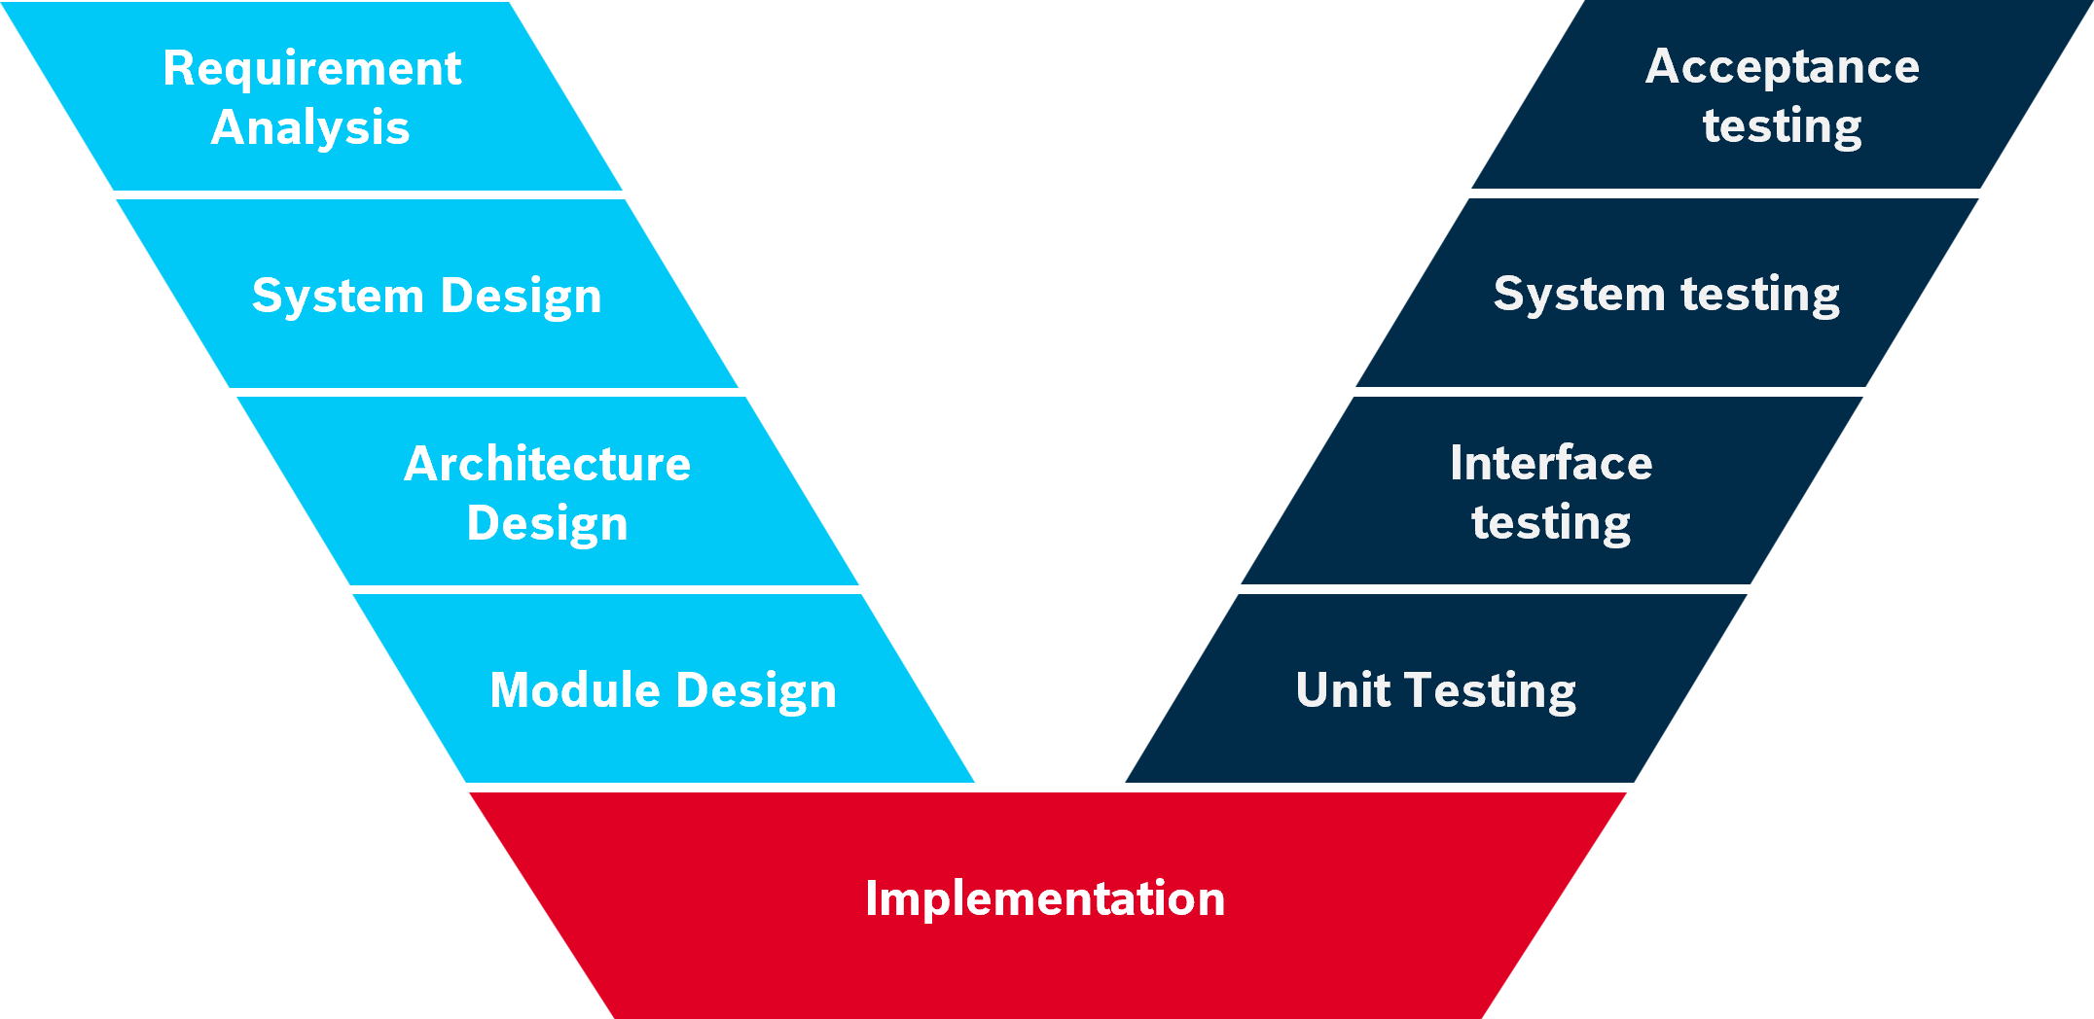
Overview
Library Development of TS1 Components
Specifications of simulation components
Provide models to Visual components
Evaluation of product information
Planning of development
Testing
Release
TS1 Evo development
V-Model Framework for System development
10/2023
All TS1 components are available for testing
Components Availability
Verification testing
(Unit test)
Current Stage
(Interface test)
Creating demonstration models
Validation Testing
Evaluation of PRM
Documentation

Slide 3
V-model for Library development
Testing of TS1 Components
The Verification & Validation (V-model) provides a formal framework for system development to ensure validity.
Requirement Analysis
Acceptance testing
System Design
System testing
Validation
Architecture Design
Interface testing
Component Design
Unit Testing
Verification
Implementation

Slide 4
General Testing Phases
Testing of TS1 Components
Alpha test : Done after implementation phase, to check if all parameters and limitations are correctly implemented and general functional testing of modelled components.
Beta test : Done after unit and interface testing, involves creation of basic models to check functionality of modelled components working together.
Release test : Validating modelled components by recreating a use case model with the new components.

Slide 5
Testing Phases
Testing of TS1 Components
Components Availability: Checking if all TS1 components are modelled as per MTPro.
Verification testing: Consists of Unit test (Parameter Validation & Geometric evaluation) and Interface test.
Creating demonstration models: Utilizing the modelled components to verify the functionality of the components by creating basic models.
Validation Testing: Testing the entire system by recreating use case model using the TS1 components for validation.
Evaluation of PRM: The developed library components are provided to product management for evaluation.

Slide 6
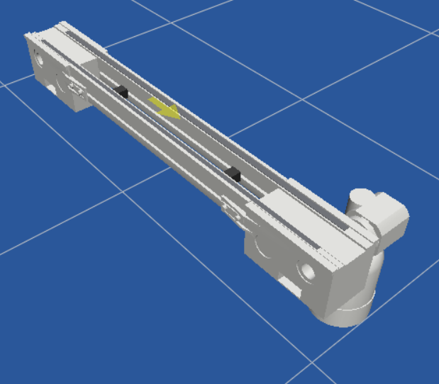
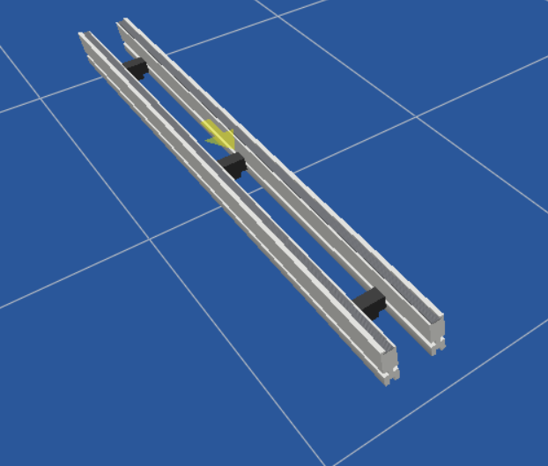
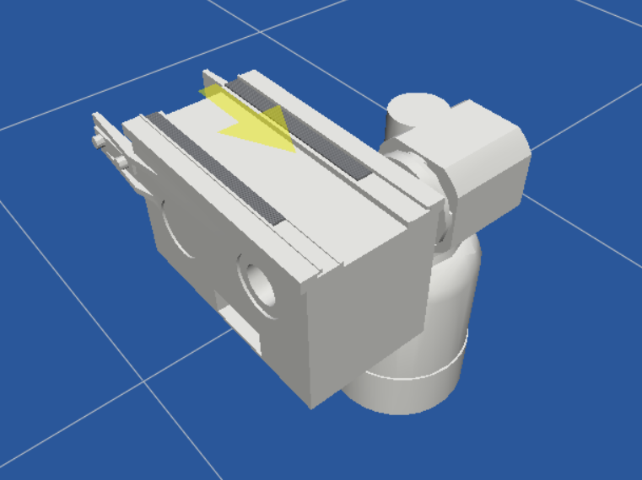
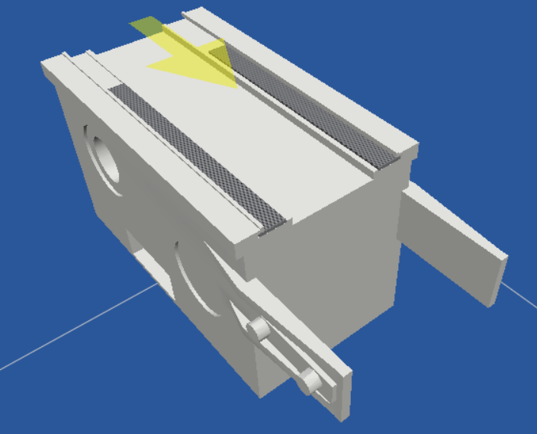
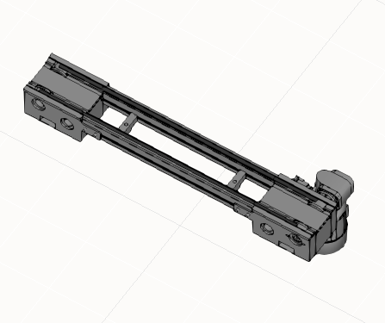
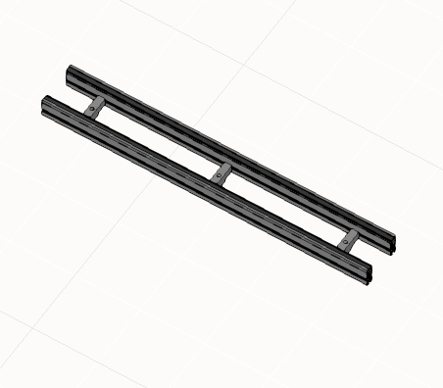
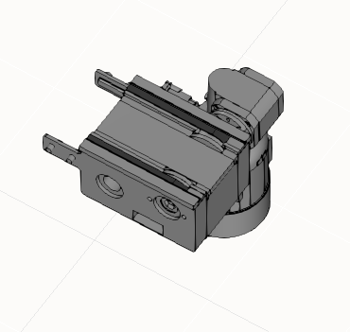
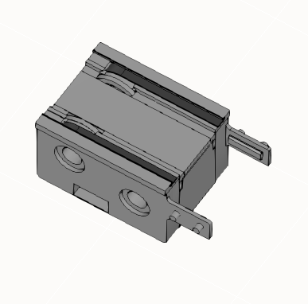
Phase 1 : Checking Component Availability for Testing
Testing of TS1 Components
Component in MTPro
Conveyor Unit
Section (ST 1)
Drive (AS 1)
Return Unit (UM1)
Modelled Component in VC

Slide 7
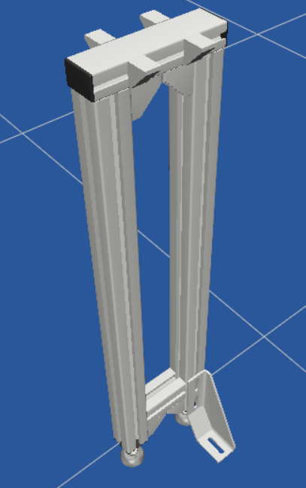
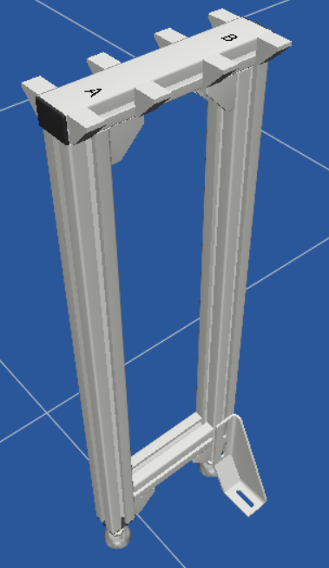
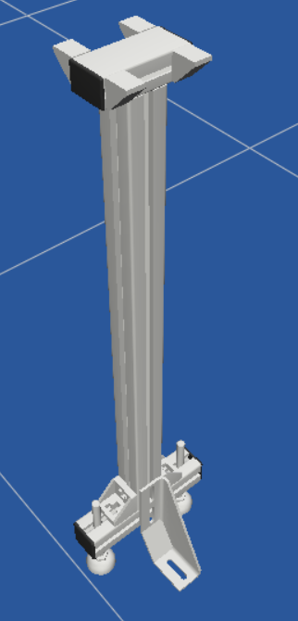
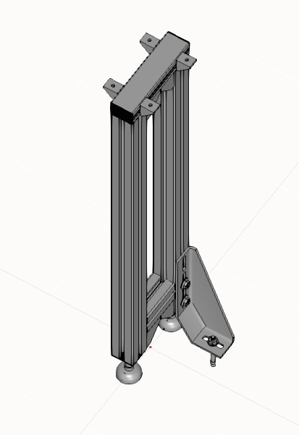
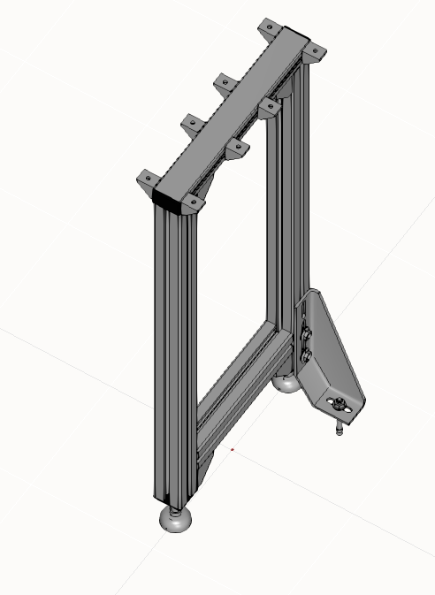
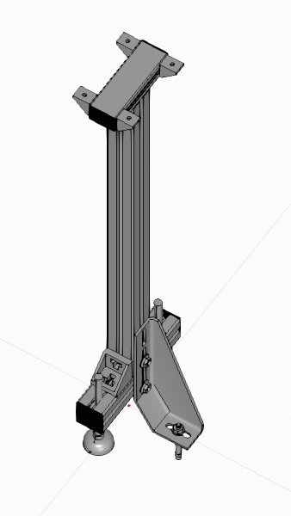
Phase 1 : Checking Component Availability for Testing
Testing of TS1 Components
Component in MTPro
Legset (SZ 1)
Legset (two tracks)
Legset (SZ 1/L)
Modelled Component in VC

Slide 8
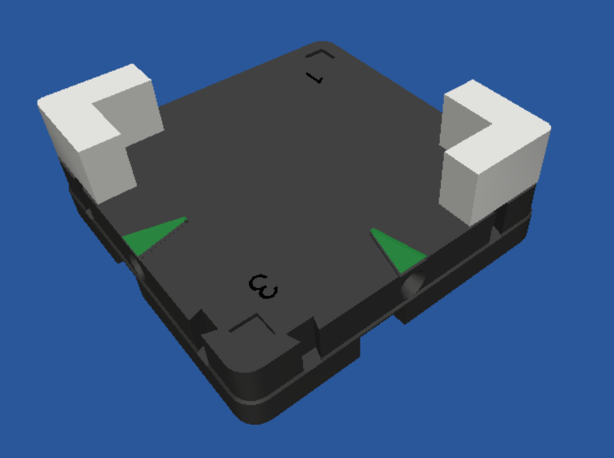
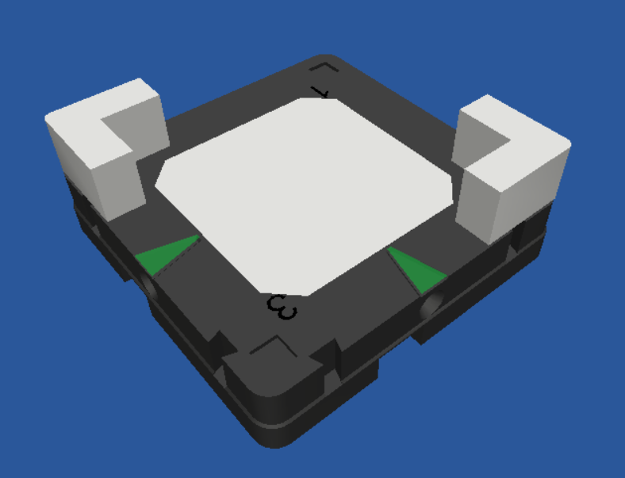
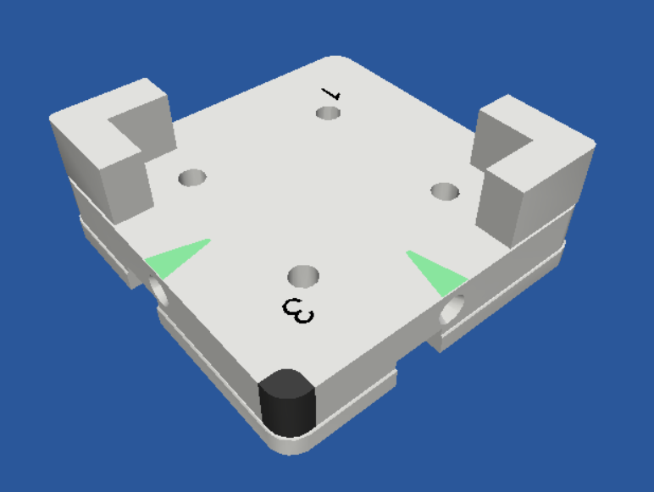
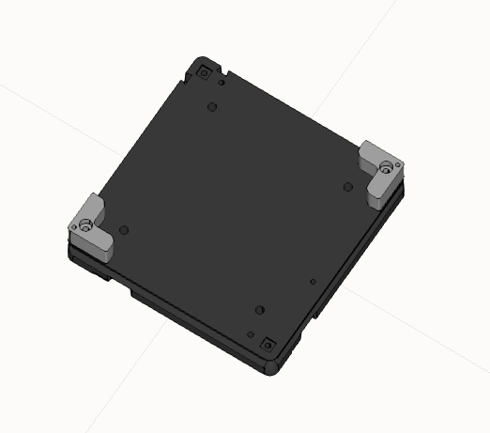
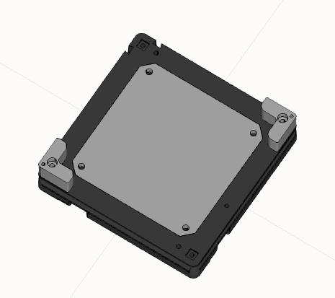
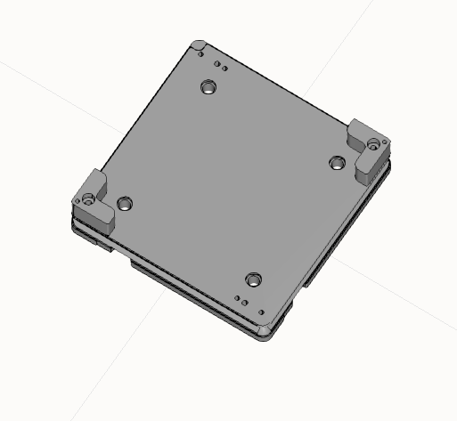
Phase 1 : Checking Component Availability for Testing
Testing of TS1 Components
Component in MTPro
Workpiece Pallet (WT 1/K)
Workpiece Pallet (WT 1/S)
Workpiece Pallet (WT 1/P)
Modelled Component in VC

Slide 9
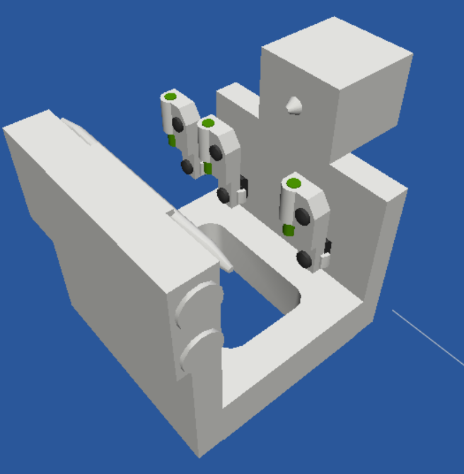
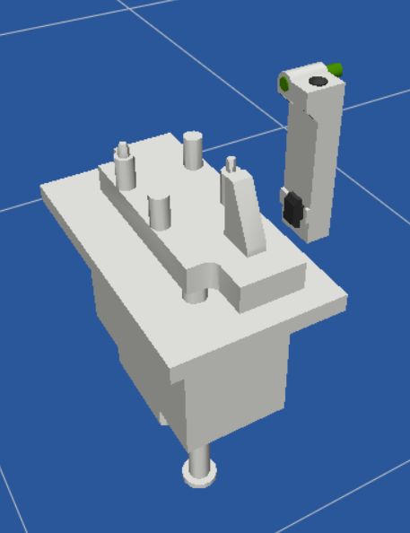
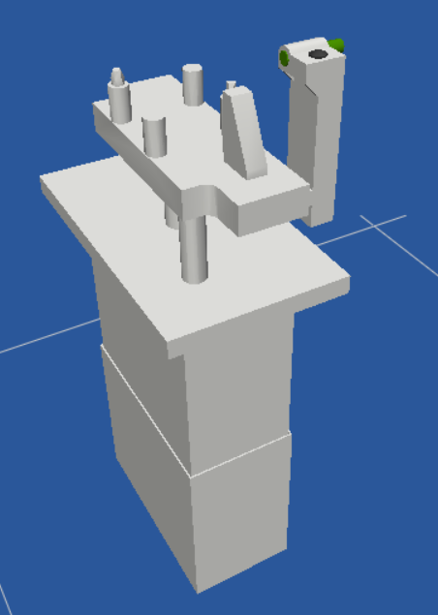
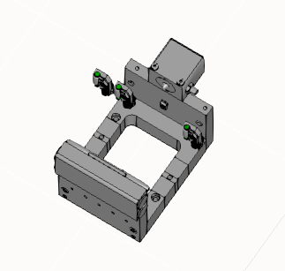
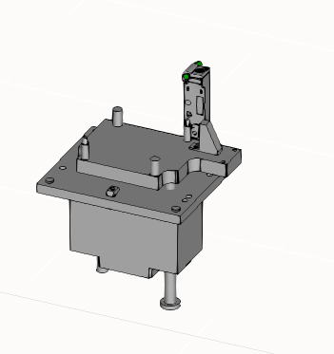
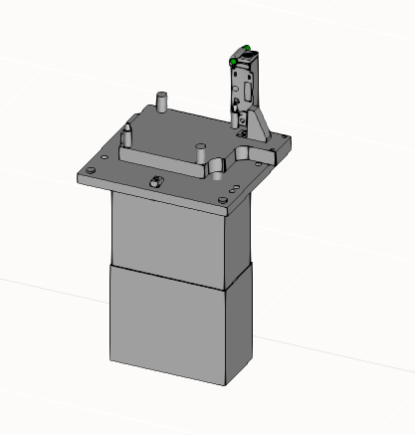
Phase 1 : Checking Component Availability for Testing
Testing of TS1 Components
Component in MTPro
Position Unit (PE 1)
Lift Position Unit (HP 1/P h=15)
Lift Position Unit (HP 1/P h=0…50)
Modelled Component in VC

Slide 10
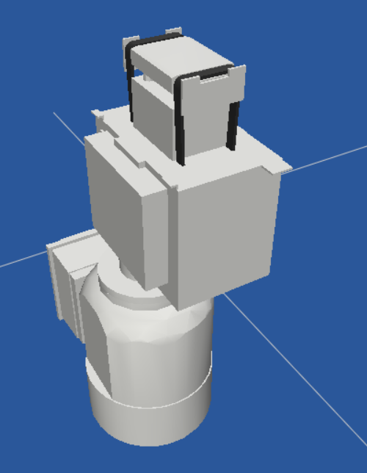
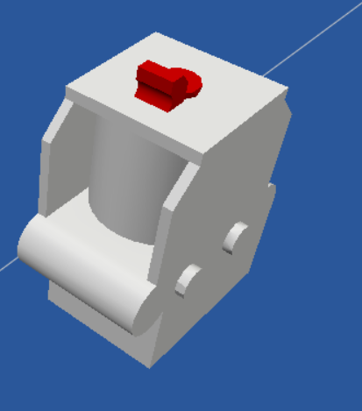
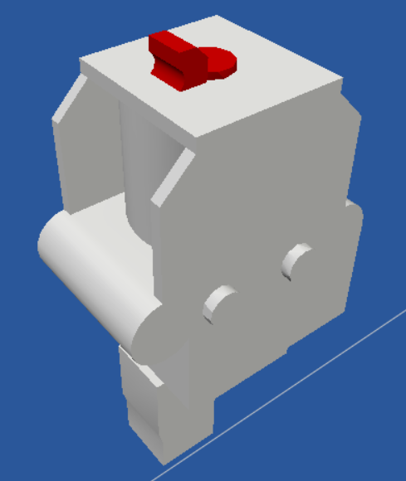
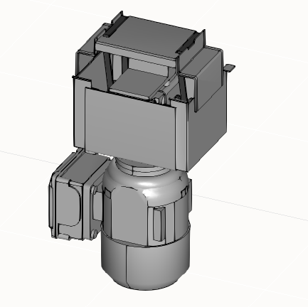
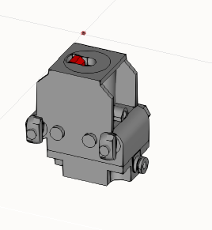
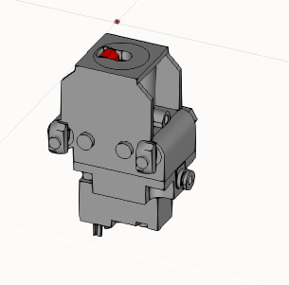
Phase 1 : Checking Component Availability for Testing
Testing of TS1 Components
Component in MTPro
Lift Transfer Unit (HQ 1/U)
Stop Gate (VE 1)
Stop Gate (VE 1/V)
Modelled Component in VC

Slide 11
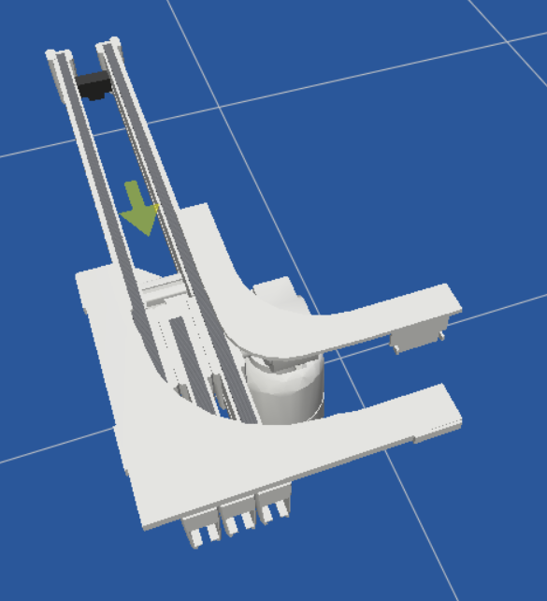
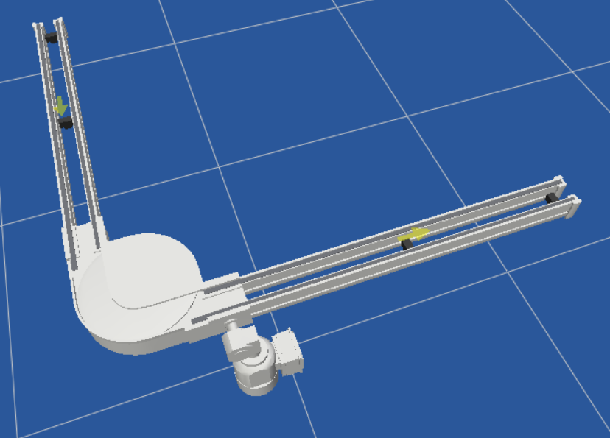
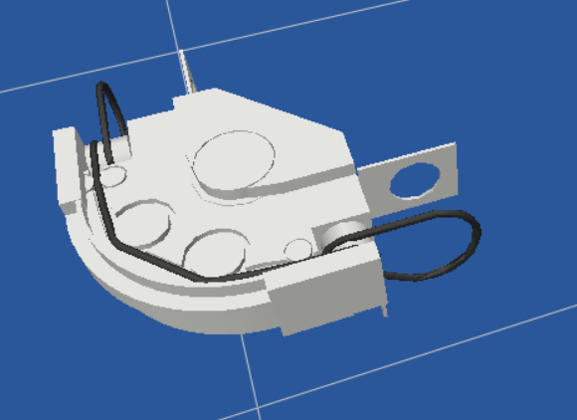
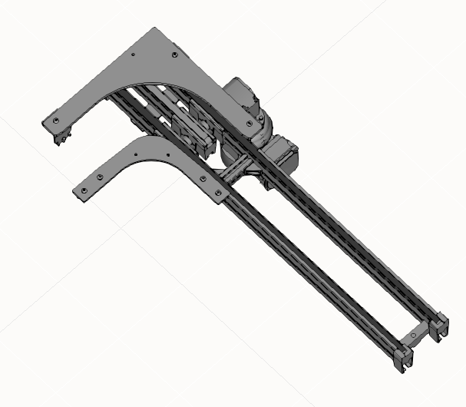
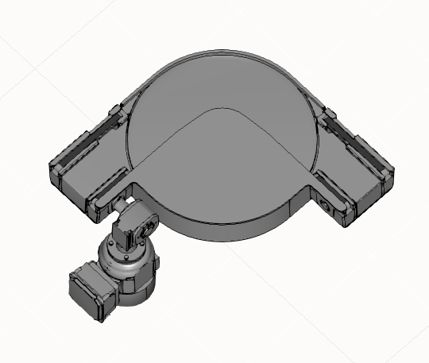
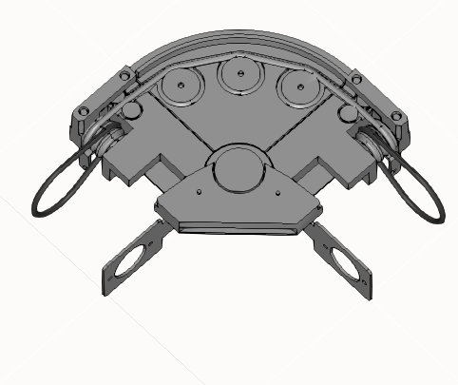
Phase 1 : Checking Component Availability for Testing
Testing of TS1 Components
Component in MTPro
Curve CU 1/90
Curve KU 1/90
Curve KU 1/90 (KE 1/O-90)
Modelled Component in VC

Slide 12
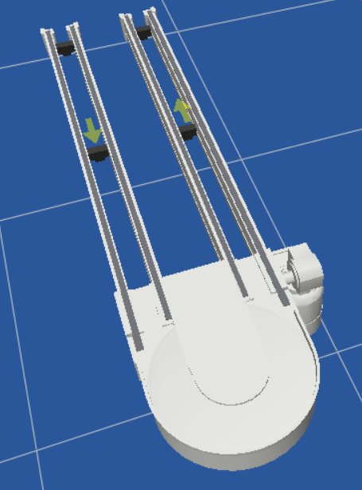
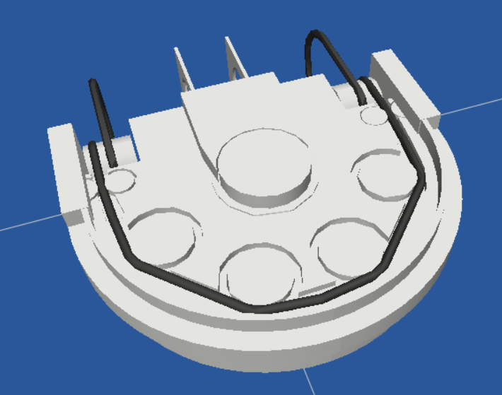
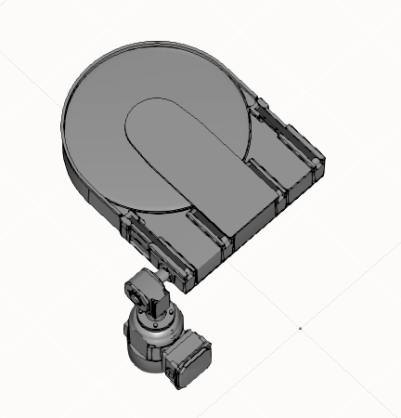
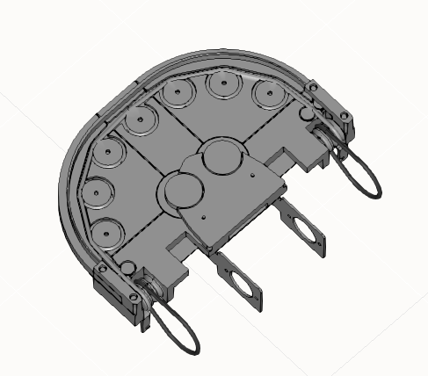
Phase 1 : Checking Component Availability for Testing
Testing of TS1 Components
Component in MTPro
Curve KU 1/180
Curve KU 1/180
(KE 1/O-180)
Modelled Component in VC

Slide 13
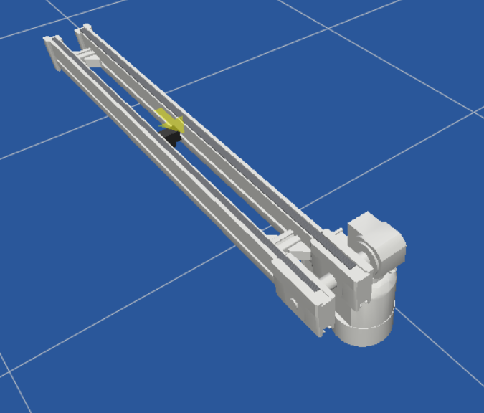
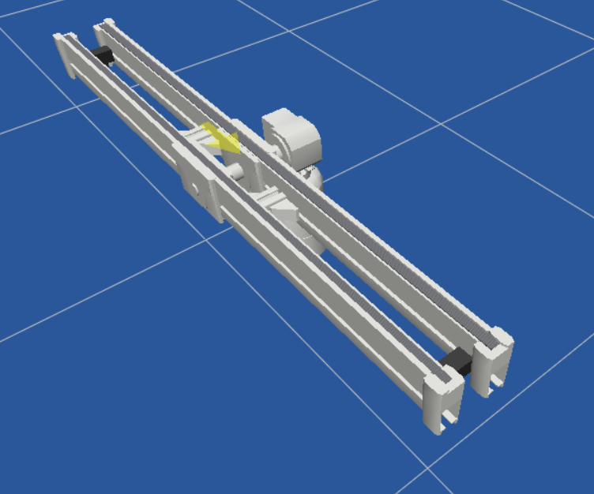
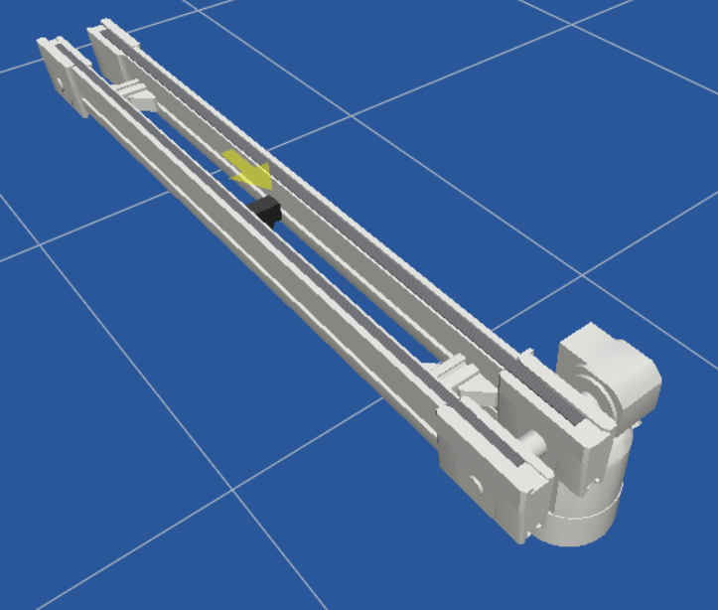
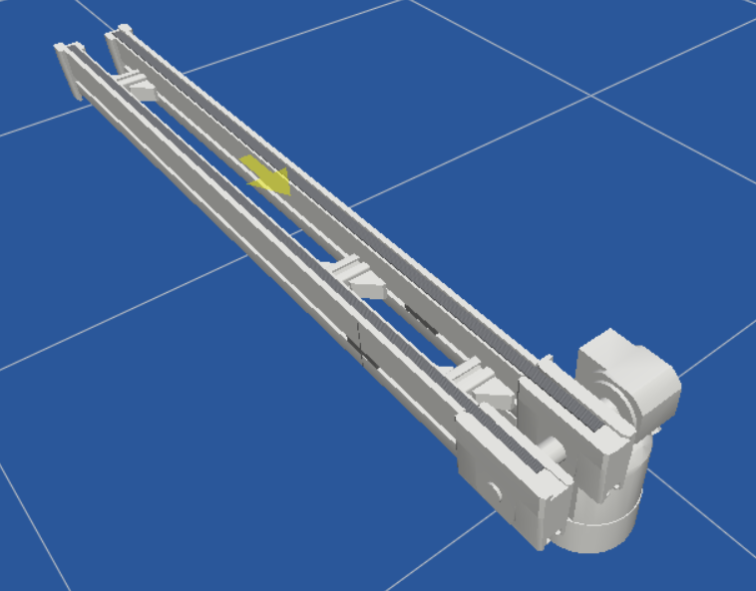
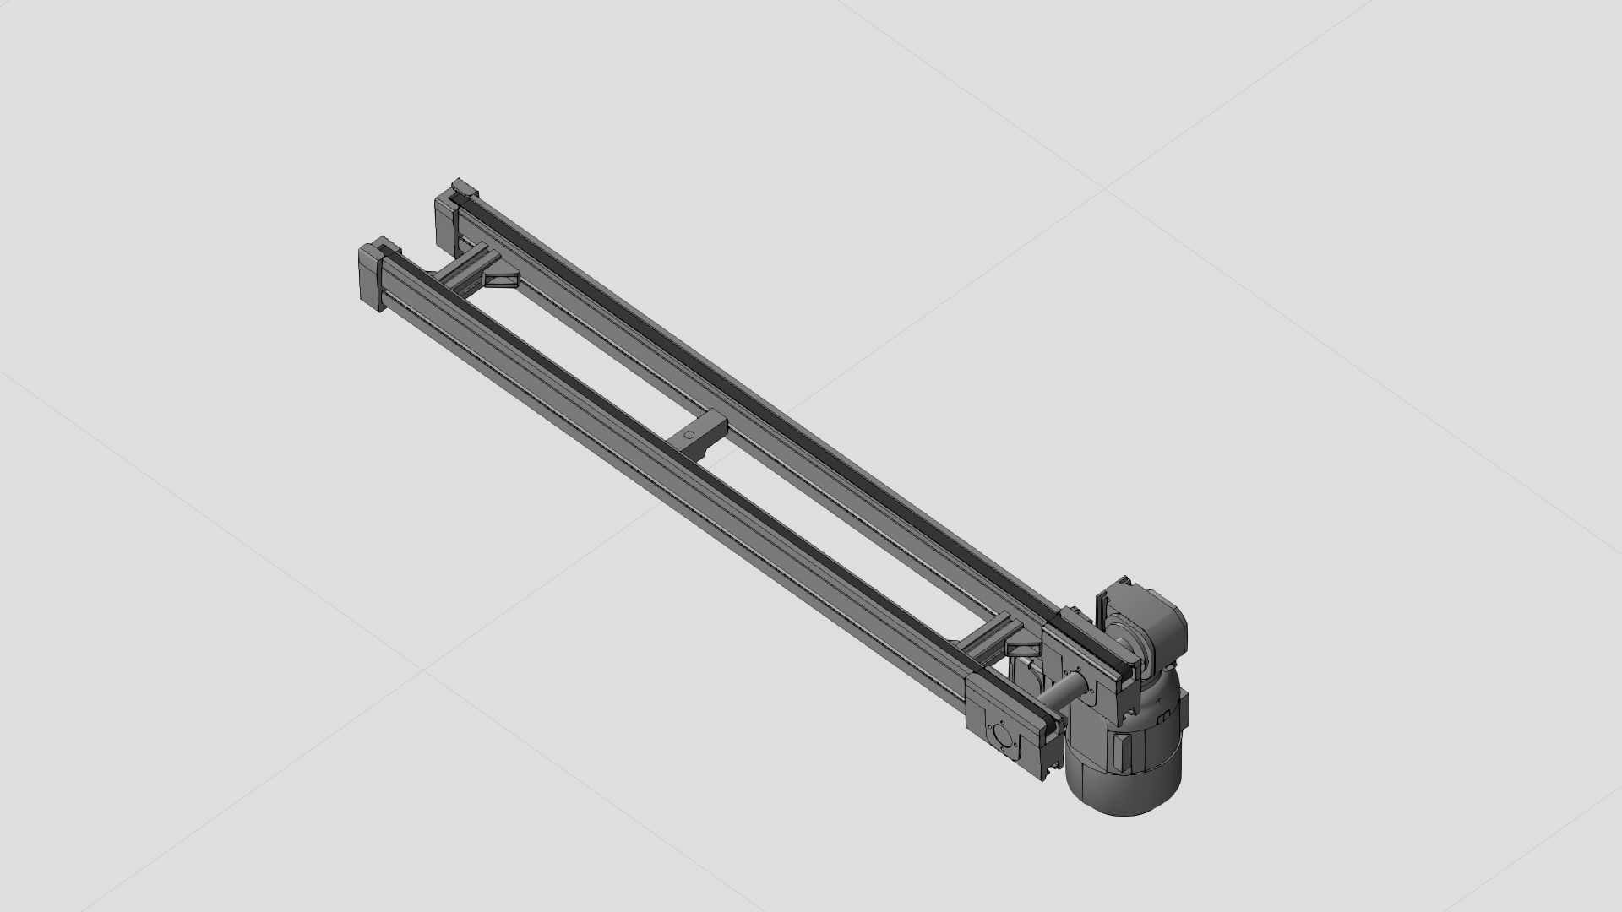
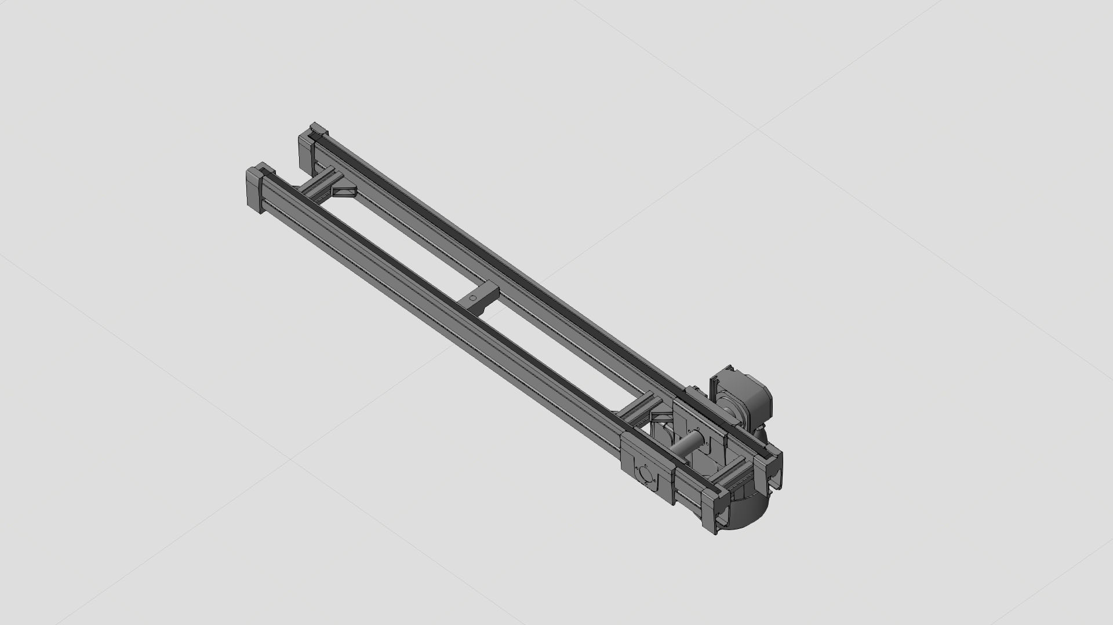

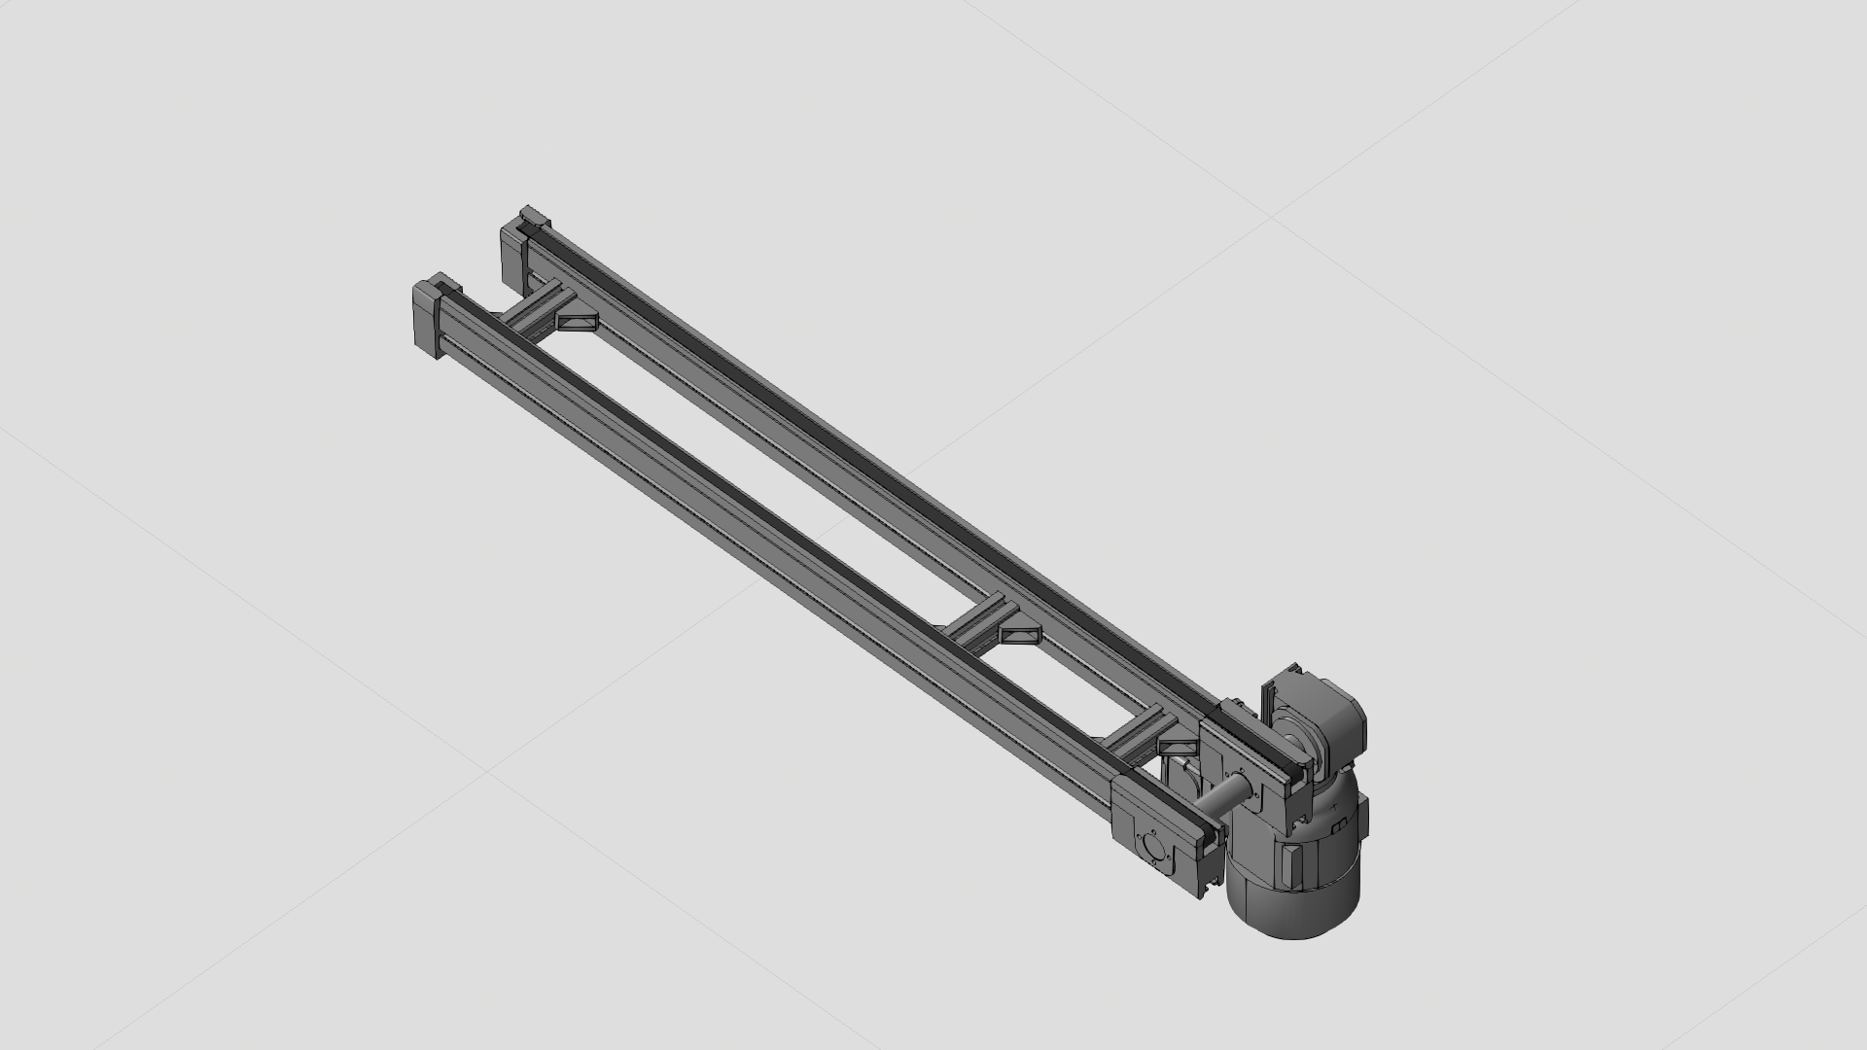
Phase 1 : Checking Component Availability for Testing
Testing of TS1 Components
Component in MTPro
BS 1
BS 1/M
BS 1/T
BS 1/S
Modelled Component in VC

Slide 14
Phase 2 : Verification Testing
Testing of TS1 Components
Unit test (Parameter Validation & Geometric Evaluation):
Verifying if all the associated parameters/attributes are properly defined and are within the required constrained limits for any individual component.
The attributes along with their data types are listed for specific variant of the component as available in MTPro and Visual Components.
The component properties, data types, default values and their limitations are counter checked for variation against the properties given in MTPro.
Additionally, evaluation of geometric changes upon manipulation of these attributes are also checked for variation.

Slide 15

Phase 2 : Verification Testing
Testing of TS1 Components
Unit test (Parameter Validation & Geometric Evaluation):
A comparison excel sheet for the data available in MTPro and Visual Components is prepared as shown below.
TS1_Library_Testing.xlsx

Slide 16
Phase 2 : Verification Testing
Testing of TS1 Components
2. Interface test:
Interface testing focuses on whether individual components interact with other components as intended.
Individual components are connected to each other and tested to verify if its functioning with the expected behavior.
To check different functionalities of the component, a structured question-based approach can be used such that each question is associated with a test to verify this functionality.
Each component will have several functionality questions and tests to verify it. The results of which are noted down in TS1_Library_Interface, Functionality test.xlsx

Slide 17
Phase 3 : Creating basic demonstration models
Testing of TS1 Components

